Slide 1

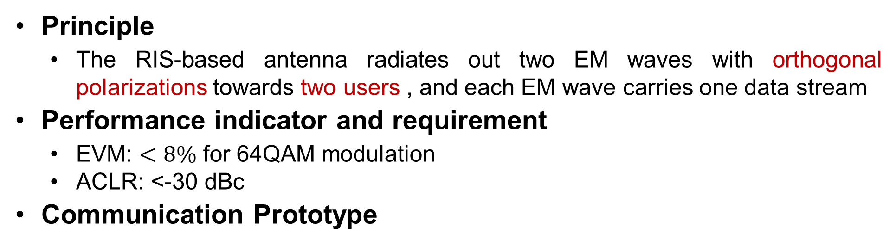
RIS-based antenna: Dual stream transmission performance
Principle
The RIS-based antenna radiates out two EM waves with orthogonal polarizations towards two users , and each EM wave carries one data stream
Performance indicator and requirement
EVM: $<8\%$ for 64QAM modulation
ACLR: <-30 dBc
Communication Prototype
One transmitter+ two receivers
Transmitter
Utilize two signal generators to output two data streams
The two data streams are radiated out through two linearly polarized RIS-based antennas, respectively.

Slide 2


RIS-based antenna: Dual stream transmission performance
Experimental setup
In a meeting room
Reflection angles for two receivers: $0^{∘}$ and ${30}^{∘}$
Tx-Rx distances: 4m
Tx antenna
RIS 1
RIS 2
$${30}^{∘}$$
Feed 1
Feed 2
Rx antenna 2
Rx antenna 1

Slide 3
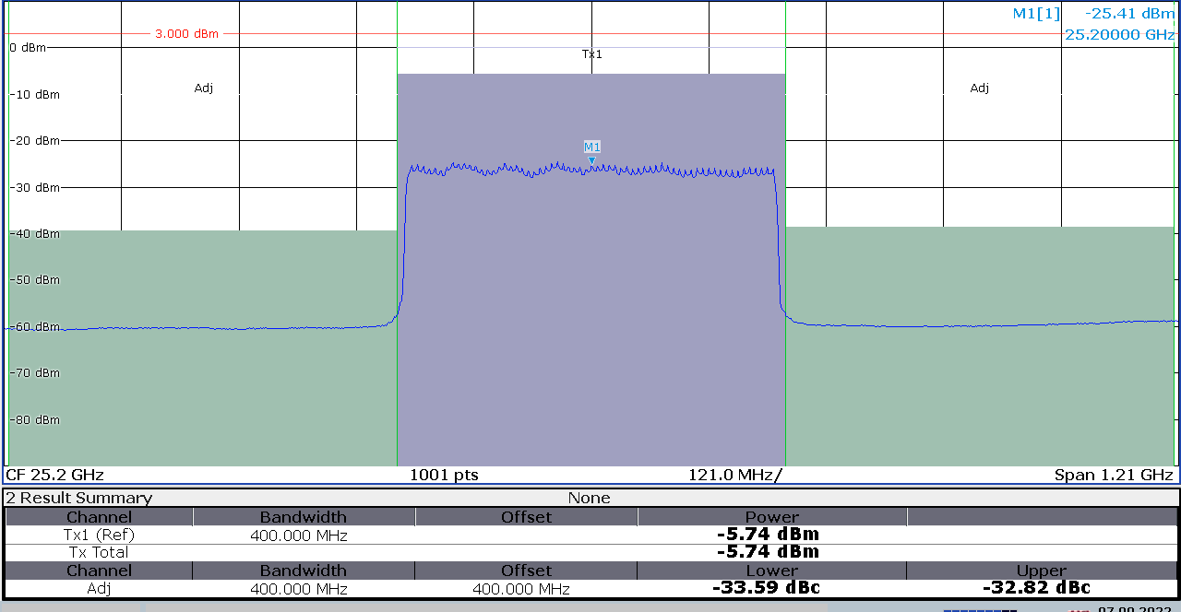
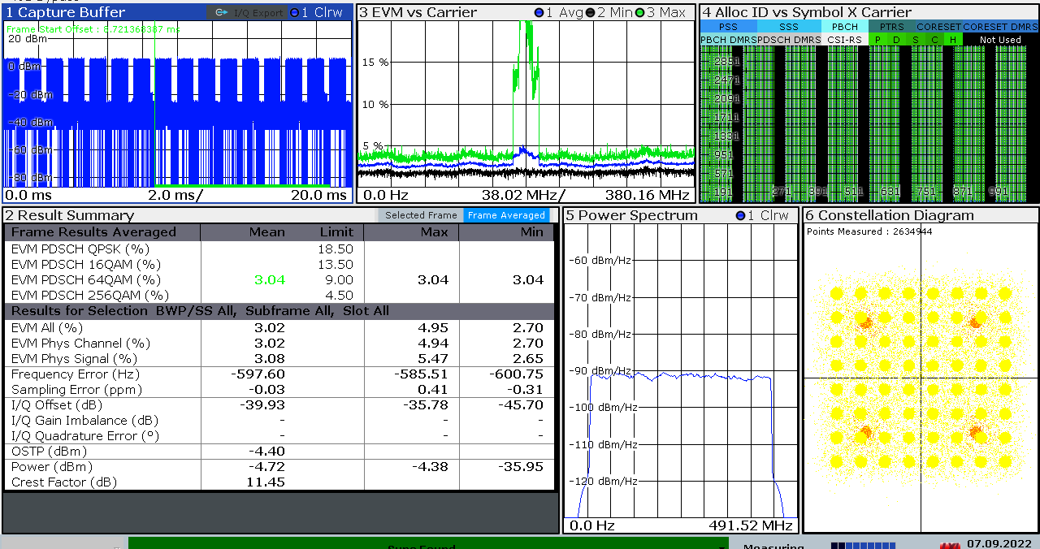
RIS-based antenna: Dual stream transmission performance
Experimental results
Rx 1
ACLR=-33.59 dBc
EVM=3.04%

Slide 4
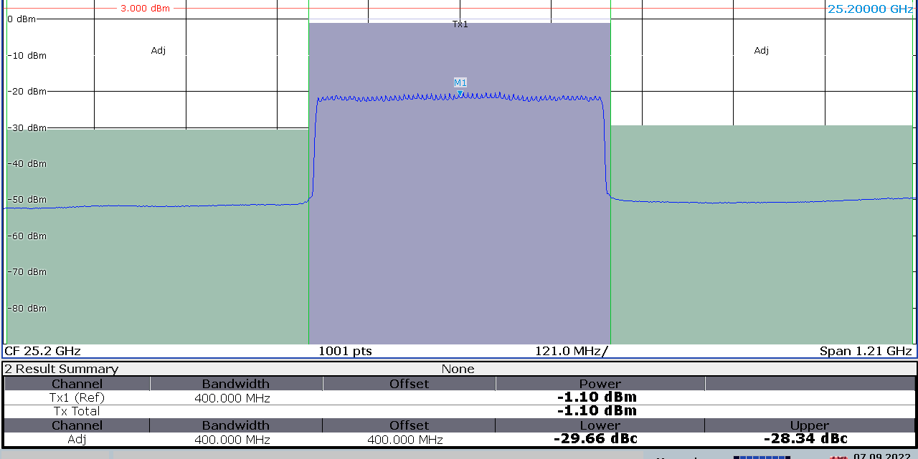
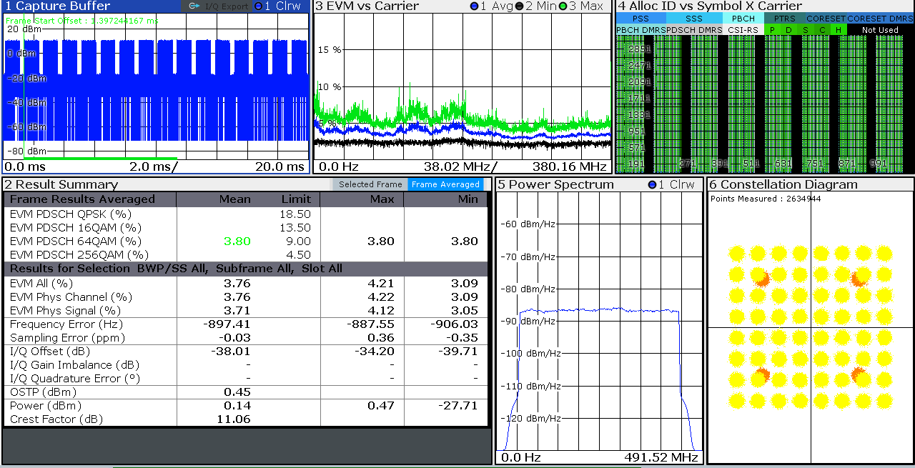
RIS-based antenna: Dual stream transmission performance
Experimental results
Rx 2
ACLR=-29.66 dBc
EVM=3.80%
Conclusion: the RIS-based antenna can support dual stream communication with satisfying EVM and ACLR

